Slide 1

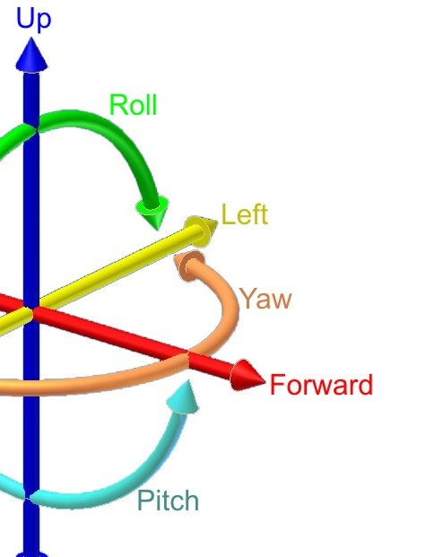
INDEPENDENT RESEARCH ON SIX DEGREES OF FREEDOM OF A MOVING BODY
Presented by: Ayush Thapa
Level: Undergraduate –Junior
Major: Mechanical Engineering

Slide 2
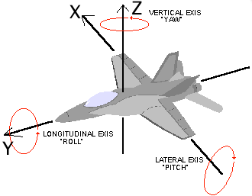
Six-degrees of freedom
Three translation on X,Y & Z axis
Three rotation on those axis (roll, pitch, and yaw)

Slide 3
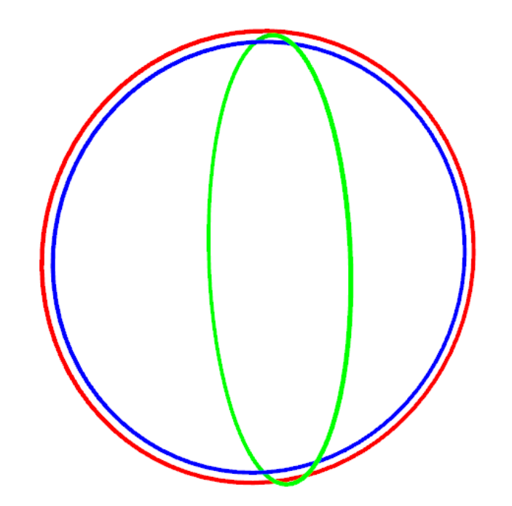
Euler’s Angle
Angle made by body frame with respect to reference frame.
Used to define rotation.
Singularity problem (Commonly known as gimble lock).
Euler’s Parameter, Principle –Axis Angle, Rodrigues Parameter

Slide 4
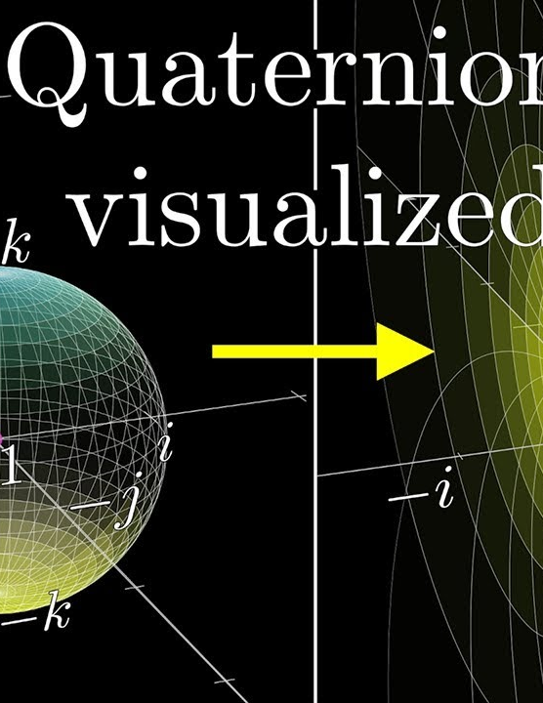
Quaternions
Euler’s Parameter is based on quaternions.
Introduction of new dimensions.
Developed by Irish Mathematician Sir William Rowan Hamilton 1843.
Based on complex number system and their operations.
Properties of Unit quaternions help to define rotation.

Slide 5
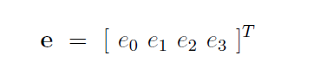
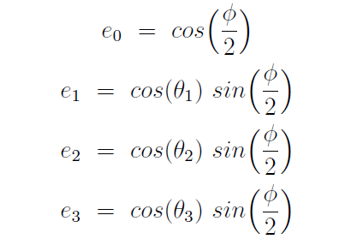
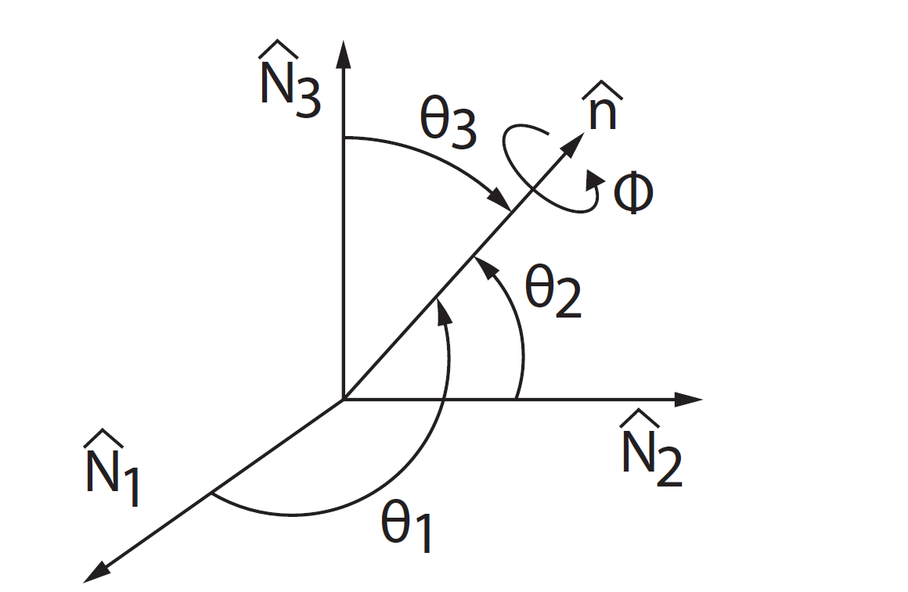
Quaternions to Rotation
Introduction to initial position using quaternions
Defining the Euler’s Parameter, in terms of Euler’s angle

Slide 6
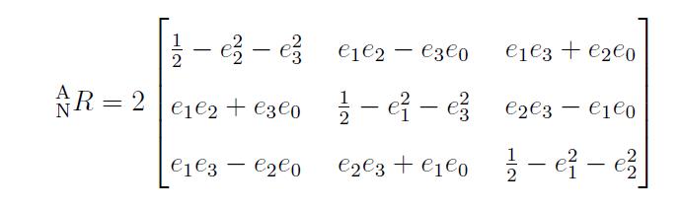
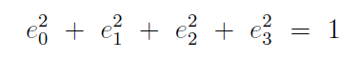
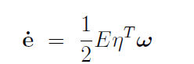
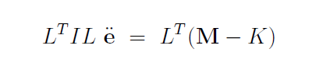
Bringing in new constraints,(Normality constraint).
Rotation matrix using Quaternions.
Defining Angular velocity in terms of time derivative of quaternions.
Using Euler’s Second Law of motion, finding differential equation to relate moment, inertial
and second derivative of quaternions.
Solving using ODE45 in Matlab.

Slide 7
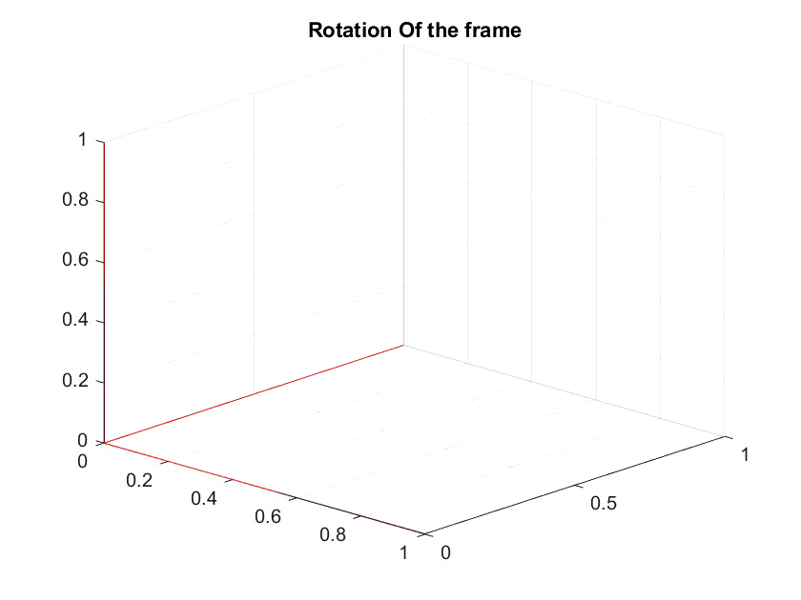
Rotation of body frame.

Slide 8
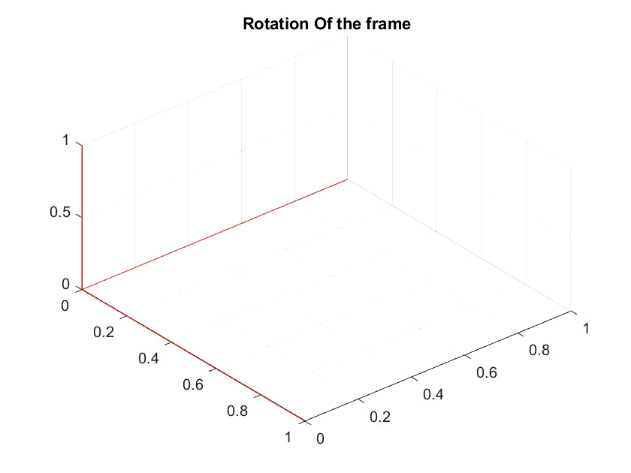
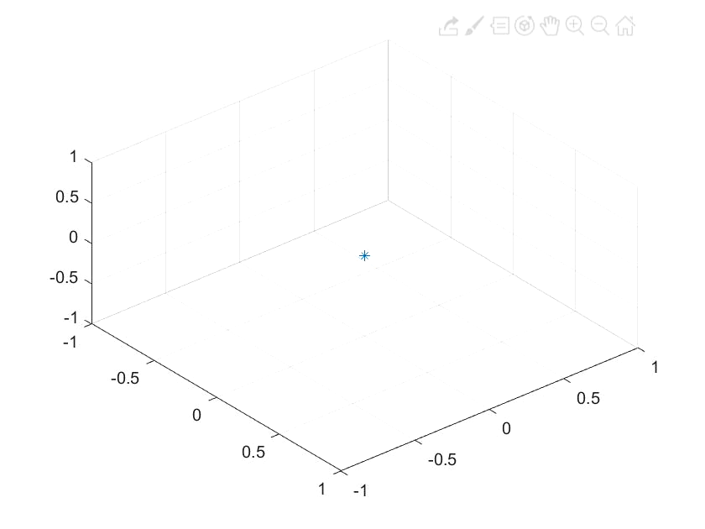
Trajectory of the body with initial velocity and cross wind

Slide 9
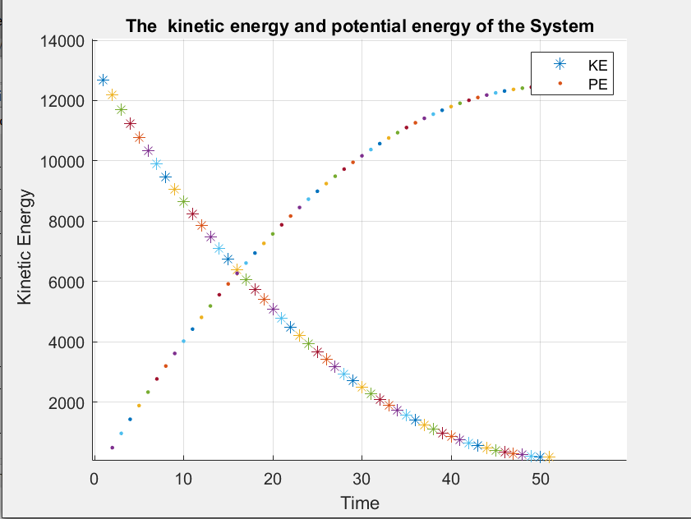
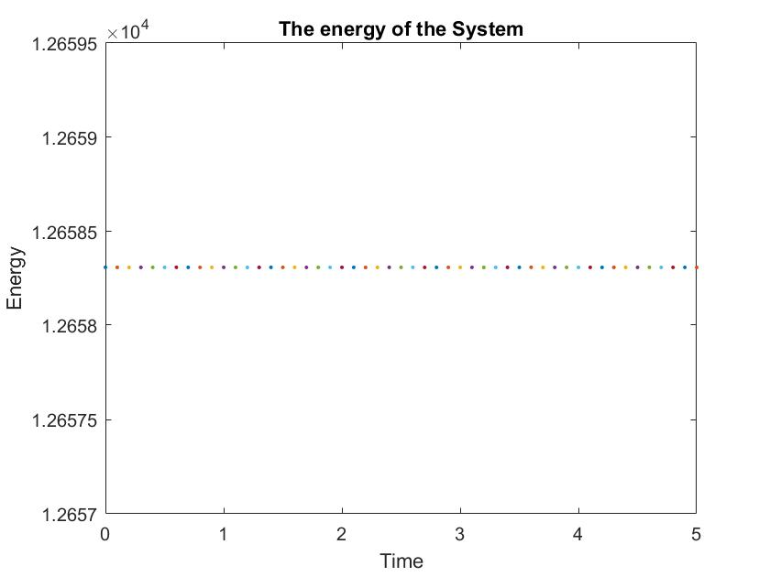
Verification of Constraints and Energy

Slide 10
